Slide 1
Dissecting Volt Typhoon for Detection Engineering
Kai Iyer

Slide 2
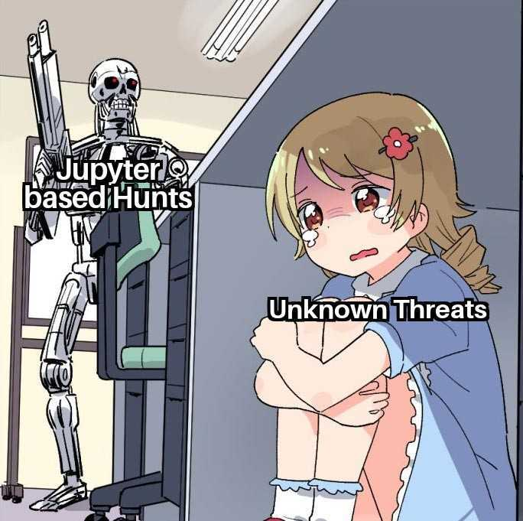
Agenda
whoami
Overview of Volt Typhoon Campaign
Understanding OT/ICS Environment
Deep Dive into OT Protocols
MITRE ATT&CK: ICS Techniques
Diving into Jupyter
Takeaways
References

Slide 3
whoami /priv
Kai Iyer
Security Engineer, Amazon
Dev, Blog, Opensource, Privacy
Marathon, Anime & Manga
find me @kaiiyer

Slide 4
Disclaimer
The views, opinions, and content presented in this presentation are solely my own and do not reflect the views, policies, or positions of my employer or any affiliated organizations. This presentation is based on my personal research, experiences, and perspectives and should not be interpreted as an official statement from my employer.
For informational purposes only—use your own discretion when applying any insights shared.

Slide 5
Overview of Volt Typhoon Campaign
Volt Typhoon is a Chinese state-sponsored actor that has been active since at least 2021 primarily targeting critical infrastructure organizations
Western Intelligence says it was part of a larger effort to infiltrate western critical infrastructure, including naval ports, internet service providers, communications services and utilities
Volt Typhoon has emphasized stealth in operations using web shells, living-off-the-land (LOTL) binaries, hands on keyboard activities, and stolen credentials

Slide 6
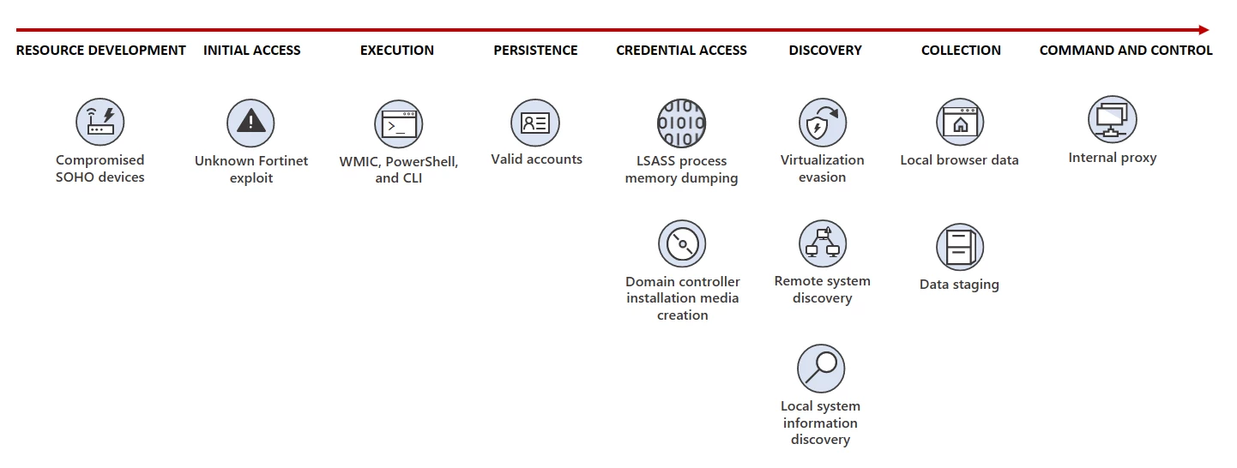
Introduction

Slide 7
Exploited Lolbas by Volt Typhoon
powershell | netsh
dnscmd | wevtutil
certutil | net user/group/use
tasklist | nltest
xcopy | wmic
ntdsutil | makecab

Slide 8
IT to OT Pivot
Exploited existing IT/OT interconnections
Used compromised credentials and VPN access
Targeted jump hosts/servers that bridged IT and OT networks
Exploited poorly segmented networks where IT and OT systems weren't properly isolated

Slide 9
Introduction to OT
What is OT?
Technology that monitors and controls physical processes in industries like manufacturing, energy, transportation, and critical infrastructure
ICS is a subset of OT that includes:
SCADA (Supervisory Control and Data Acquisition) – Manages dispersed assets
DCS (Distributed Control Systems) – Controls complex industrial processes
PLCs (Programmable Logic Controllers) – Execute real-time automation tasks
Key Characteristics of OT/ICS:
Legacy systems (Windows XP, proprietary firmware, no patches)
Deterministic operations (predictable traffic patterns)
Air-gapped (historically) – Now increasingly connected to IT/cloud
Notes:
physical processes (e.g., factory machines, power grids, water treatment)

Slide 10
Understanding OT/ICS Environment
Category | OT/ICS Systems | IT Systems
Availability | Zero downtime tolerated (outages = physical/financial disasters) | Rebooting, patching, and maintenance windows are routine
Traffic Patterns | Deterministic (predictable, time-synchronized traffic for control loops) | Highly variable (bursty, user-driven traffic like web browsing)
System Lifespan | Legacy OS/firmware (Windows XP, proprietary systems, no patches) | Regular updates (automated patches, modern OS support)
Protocols | Industrial protocols (MODBUS, DNP3, BACnet) – designed for real-time control | Standard IT protocols (HTTPS, DNS, SMTP) – designed for data exchange
Security Focus | Availability + Safety (prevent physical harm) | Confidentiality + Integrity (protect data, prevent breaches)

Slide 11


Deep Dive into OT Protocols
1. DNP3 (Distributed Network Protocol)
Purpose: Secure SCADA communication (master-outstation architecture) in Electric power systems and water utilities
Key Features:
Supports unsolicited responses
Functions: Read, Write, Freeze
Detection Idea:
Alert on Function Code 7 (Freeze) outside maintenance windows
Monitor for outstation-originated requests (sign of reconnaissance)
Ethernet Note: Runs over TCP/IP (port 20000) but lacks native encryption
Photo by David Levêque on Unsplash

Slide 12
Deep Dive into OT Protocols
2. BACnet (Building Automation)
Purpose: Controls HVAC, lighting, and physical access systems
Key Features:
Objects (e.g., AnalogValue, BinaryOutput) manipulated via ReadProperty/WriteProperty
Broadcast-heavy (vulnerable to spoofing)
Detection Idea:
Flag WriteProperty to critical devices (e.g., temperature sensors).
Baseline normal BACnet device IDs (unregistered devices = rogue nodes)
Ethernet Note: Uses UDP/47808 (BACnet/IP) or MS/TP (serial)
Photo by David Levêque on Unsplash

Slide 13

Deep Dive into OT Protocols
3. Modbus (Industrial Workhorse)
Purpose: Master-slave communication for sending commands and reading sensor data
Key Features:
Function codes: Read Coils (1), Write Registers (6), Diagnostics (8)
No authentication – attackers spoof Unit IDs
Detection Idea:
Detect Write Multiple Registers to critical PLCs (e.g., valve controls)
Watch for unusual polling rates (DoS or mapping attempts)
Ethernet Note: Modbus/TCP uses port 502; plaintext protocol.
Photo by Patrick Federi on Unsplash
Notes:
PLC-to-device communication (simple request/reply)

Slide 14
Deep Dive into OT Protocols
4. Ethernet/IP (Industrial Ethernet)
Purpose: Real-time control and communication in industrial automation(CIP protocol)
Key Features:
Encapsulates CIP objects (e.g., Assembly, IO Connection, Parameter)
Implicit messaging (real-time data) vs. explicit (config changes)
Detection Idea:
Alert on new CIP Class 3 connections (unauthorized devices)
Monitor ForwardOpen requests (used for lateral movement)
Ports: TCP/44818, UDP/2222.
Photo by Patrick Federi on Unsplash
Notes:
PLC-to-device communication (simple request/reply)

Slide 15

Deep Dive into OT Protocols
Protocol | Port | Ethernet Adaptation | Key Attack Vector | Security Implications
DNP3 | 20000 | DNP3/IP (TCP) | Freeze command abuse | No encryption → Spoofing/MitM risks
BACnet | 47808 | BACnet/IP (UDP) | WriteProperty tampering | Broadcast-heavy → Spoofing/DoS
Modbus | 502 | Modbus/TCP | Write_Register to PLCs | Plaintext → Replay attacks
Ethernet/IP | 44818 | CIP over TCP | Malicious ForwardOpen | Implicit messaging → Blind trust
Photo by Mick Truyts on Unsplash

Slide 16
MITRE ATT&CK: ICS Techniques
1. Discovery (TA0102)
What: Mapping control logic via MODBUS/DNP3 registers
How to detect: Bulk register reads (>50 registers)
Real-World Example: Scan water treatment PLCs to find chemical dosing controls
2. Lateral Movement (TA0109)
What: Pivoting between protocols using remote services
How to detect: RDP/SMB connections from OT devices
Real-World Example: Use HVAC controllers (BACnet) → Engineering WS (RDP) → Substation (DNP3)
Photo by Mick Truyts on Unsplash
Notes:
Mapping control logic BACnet object properties // Leverages dual-homed devices (IT/OT boundary systems) as pivot points

Slide 17
MITRE ATT&CK: ICS Techniques
3. Execution (TA0104)
What: Unauthorized control via protocol-native commands
How to detect: Command sequences violating operational baseline
Real-World Example: Send WRITE_MULTIPLE_REGISTERS to override valve positions or disable pressure alarms
4. Impact (TA0105)
What: Physical process manipulation
How to detect: Process anomalies contradicting sensor telemetry
Real-World Example: Override level sensors to overflow chemical tank
Photo by Mick Truyts on Unsplash
Notes:
MODBUS WRITE_MULTIPLE_REGISTERS // DNP3 DIRECT_OPERATE // BACnet WriteProperty
Detect PLC mode changes to PROGRAM

Slide 18
Diving into Jupyter
Enough slides, show me the actual stuff!!!

Slide 19

Takeaways
Overview of Volt Typhoon Campaign
How OT differs from mainstream IT
Fundamentals of popular OT protocols
Map OT Detections to MITRE ATT&CK
Jupyter based Detection Engineering
Enhancing Detections with ML

Slide 20
Questions?

Slide 21
References
https://www.obriain.com/training/BandD3/odp/Topic_6-SCADA-Notes.pdf
https://www.nerc.com/pa/Stand/Reliability%20Standards/CIP-002-1.pdf
https://attack.mitre.org/groups/G1017
https://www.cisa.gov/news-events/cybersecurity-advisories/aa24-038a
https://www.scadalink.com/support/knowledge-base/an-introduction-to-scada
https://www.vtscada.com/help/Content/D_Tags/Dev_DNPObjTypes.htm
https://www.picussecurity.com/resource/blog/volt-typhoon-the-chinese-apt-group-abuse-lolbins-for-cyber-espionage
https://twitter.com/BushidoToken/status/1757738132143779999
https://www.theguardian.com/technology/2024/feb/13/volt-typhoon-what-is-it-how-does-it-work-chinese-cyber-operation-china-hackers-explainer
https://www.microsoft.com/en-us/security/blog/2023/05/24/volt-typhoon-targets-us-critical-infrastructure-with-living-off-the-land-techniques/

Slide 22
Thank You

